Slide 1

Sprint 2, Team 6
Cameron Chambers, Cedric Rutijana, Ricardo Gonzalez Mendez, Zuhdi Abujayyab, Yubin Hu, Zixi Rao

Slide 2
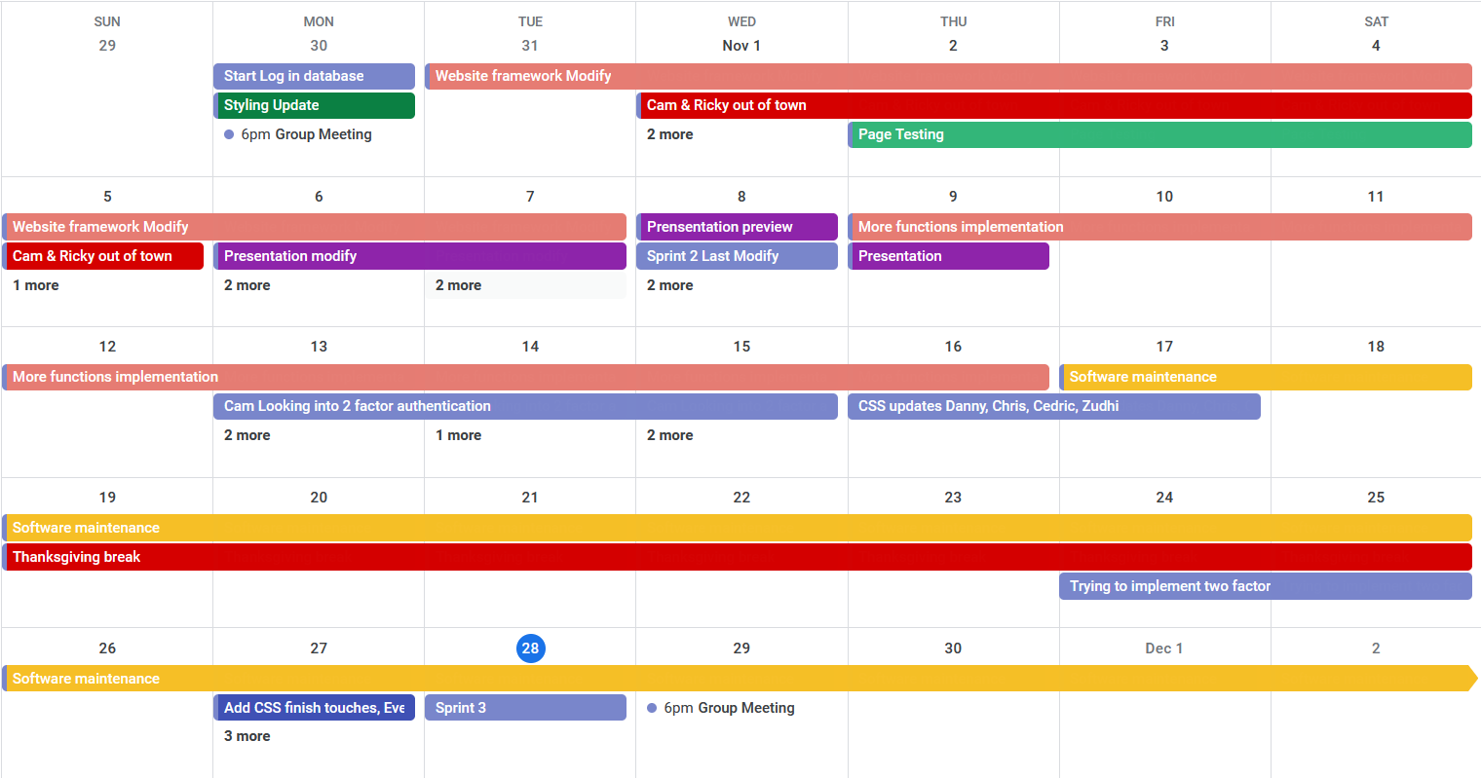
Project Calendar
https://calendar.google.com/calendar/embed?src=yubinhu%40suumail.net&ctz=America%2FDenver

Slide 3
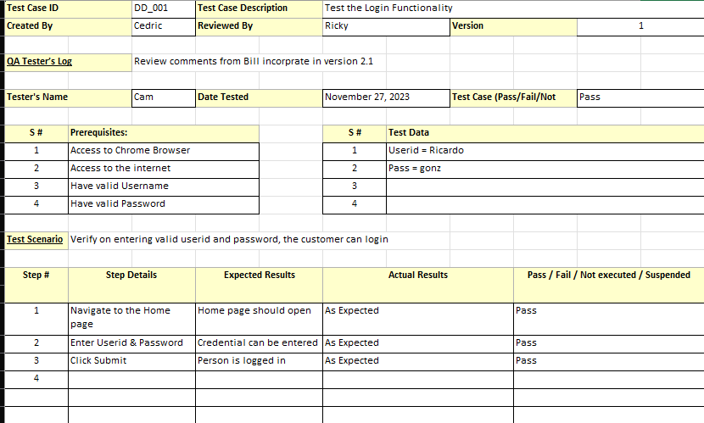
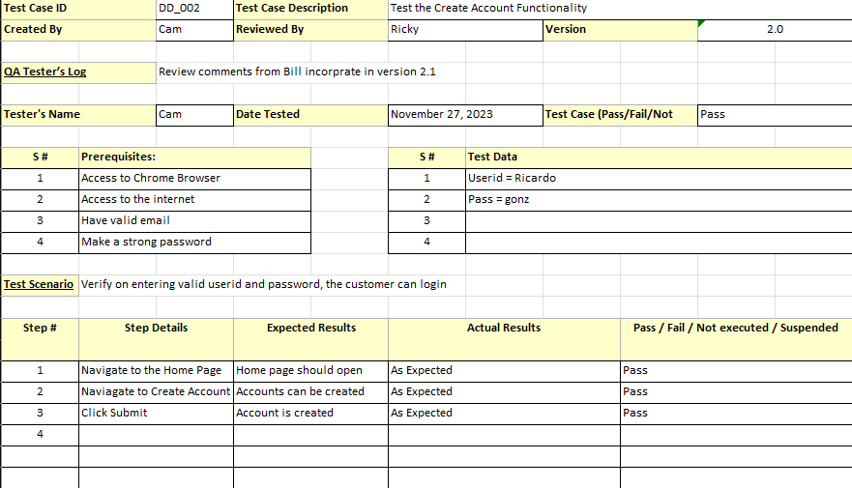
Test Cases
Below are two test cases for our project.

Slide 4
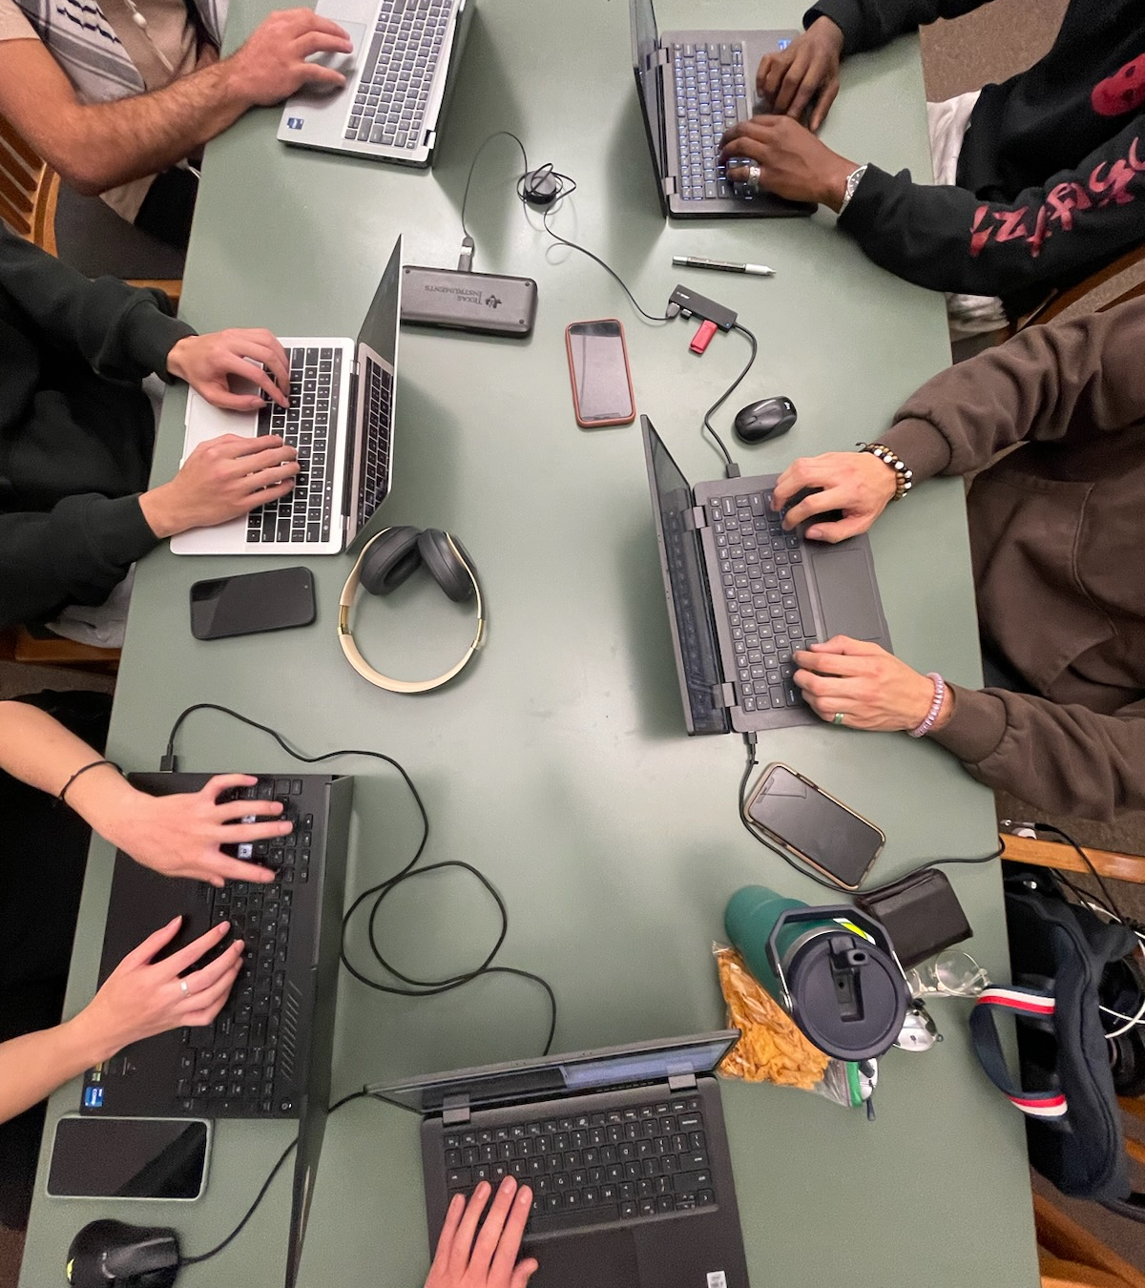
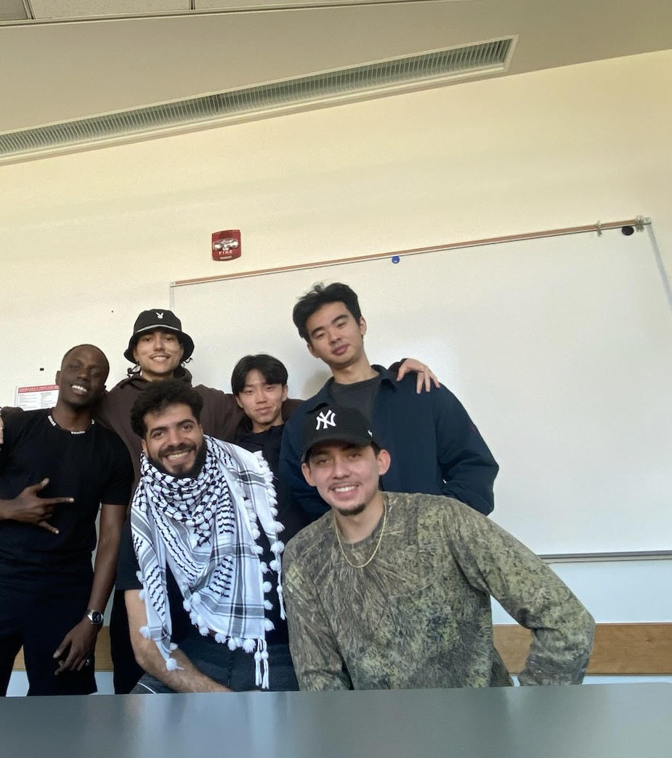
Throughout the duration of our project, we managed to accomplish just about all of our goals. We were able to develop a functional website geared towards aiding individuals seeking help through distressful times.
Our Project,
What We Built

